Slide 1
SBI Banking Customer Analysis
Excel Dashboard Project using Power Query, Formulas, Pivot Tables & Charts
- By
RAJAPRIYANKA

Slide 2
Project Abstract
Analyze SBI banking customer behavior and account activity
Understand customer distribution by age, state and banking usage
Track deposits, balances, loans and digital banking adoption
Build interactive Excel dashboard for business insights
Use Power Query, formulas, pivot tables and charts for analysis

Slide 3
Workbook Structure
Raw_Data Sheet – Contains 1000 customer records and 24 columns
Formulas Used Sheet – KPI calculations and Excel formulas
Pivot_Tables Sheet – Pivot summaries for analysis
Dashboard Sheet – Final visual dashboard and KPI cards
Data includes balances, loans, transactions, satisfaction and digital banking

Slide 4
DATASET DOWNLOAD -USING KAGGLE
What is Kaggle used for?
Downloading datasets
Learning Data Science
Practicing Projects
Competitions
Using Notebooks

Slide 5
DATASET DOWNLOAD -USING KAGGLE
Steps to Get Dataset from Kaggle
Step 1: Open Kaggle Website
Step 2: Create Account / Login
Step 3: Search Dataset
Step 4: Open Dataset
Step 5: Download Dataset
Step 6: Extract ZIP File (if needed)

Slide 6
Step 1 – Import Data using Power Query
Open Excel workbook and go to Data → Get Data
Select Excel Workbook and load the SBI dataset
Choose Raw_Data sheet inside Power Query Editor
Verify data types for numbers, text and dates
Load cleaned data into Excel table for analysis

Slide 7
Step 2 – Data Cleaning in Power Query
Removed blank rows and checked duplicate customer IDs
Formatted Age, Balance and Loan Amount columns as numeric
Standardized text values like Gender and Loan Status
Validated Customer_Since and tenure related columns
Prepared clean dataset for dashboard reporting

Slide 8
Step 3 – Data Understanding
Total Customers: 1000
Total States Covered: 13
Account Types: Savings, Salary, Current
Main fields include Balance, Transactions, Credit Score and Loan Status
Dataset supports customer, financial and digital banking analysis

Slide 9
Conditional Formatting
Method 1: Highlight Cells Greater Than a Value
1. Select the cells containing numbers.
2. Go to Home → Conditional Formatting.
3. Click Highlight Cells Rules → Greater Than.
4. Enter the value “number”.
5. Choose a formatting color.
6. Click OK.
Method 2: Color Scale
7. Select the data range.
8. Go to Home → Conditional Formatting.
9. Click Color Scales.
10. Choose a color style.

Slide 10
Conditional Formatting
Method 3: Data Bars
11. Select the data.
12. Go to Home → Conditional Formatting.
13. Click Data Bars.
14. Choose a bar color.
Method 4: Icon Sets
15. Select the cells.
16. Go to Conditional Formatting.
17. Click Icon Sets.
18. Choose an icon style.

Slide 11
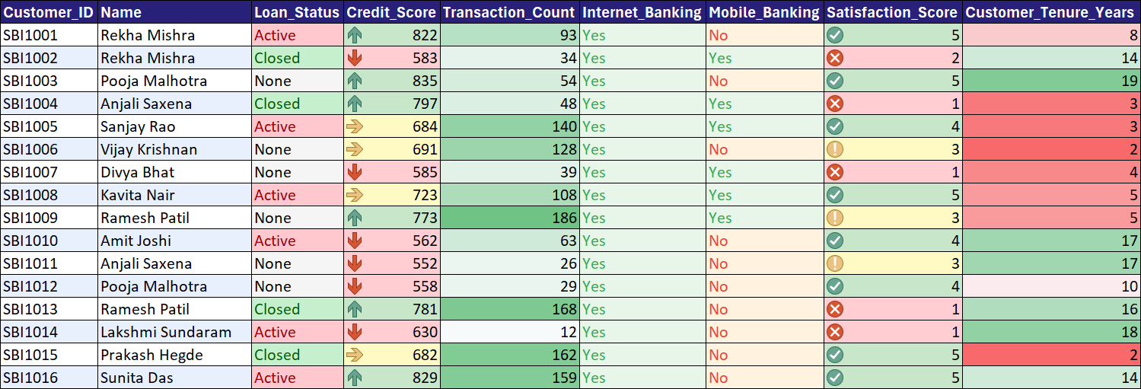

Slide 12
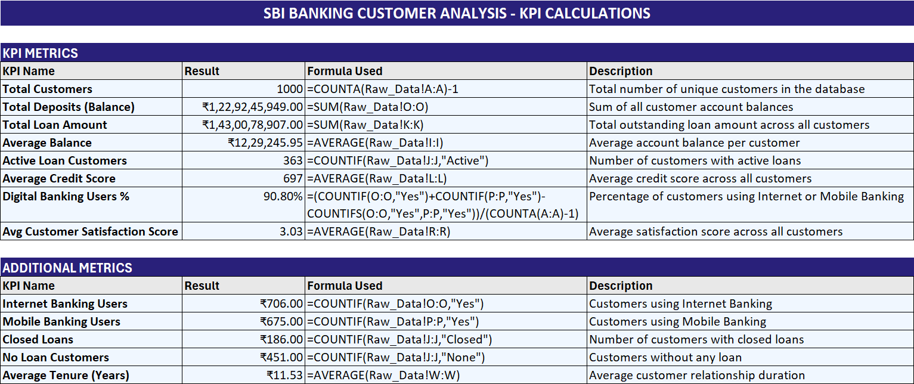
Step 4 – KPI Formulas Used

Slide 13
Step 5 – Pivot Table Creation
Inserted Pivot Tables from cleaned dataset
Created Age Group vs Customer Count analysis
Built State-wise customer distribution pivot
Analyzed transaction count and account balances
Generated loan and digital banking summaries

Slide 14
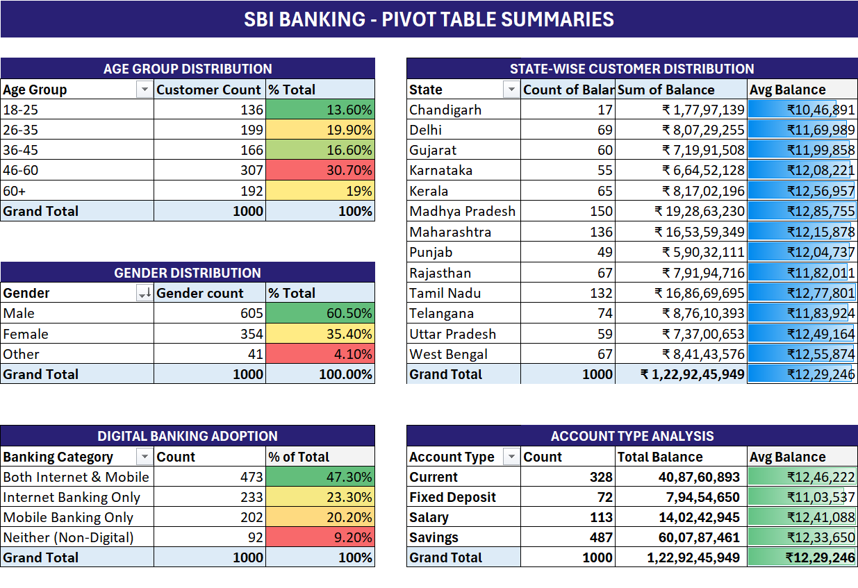

Slide 15
Customer Distribution Analysis
Madhya Pradesh: 150 customers
Maharashtra: 136 customers
Tamil Nadu: 132 customers
Telangana: 74 customers
Delhi: 69 customers
Pivot charts were used for demographic comparison

Slide 16
Deposits and Balance Insights
Average Customer Balance: ₹1,229,245
Highest Balance Recorded: ₹2,498,099
VIP customers maintain significantly higher balances
Savings accounts contribute major customer volume
Balance trends visualized using column charts

Slide 17
Loan Behavior Analysis
Active Loans: 363
Closed Loans: 186
Loan amount and status analyzed through pivot tables
Customers with higher credit scores showed lower risk
Loan trends visualized using pie and bar charts

Slide 18
Digital Banking Adoption
Mobile Banking Users: 675
Internet Banking Users: 706
Digital adoption compared across customer categories
Mobile banking usage highest among young professionals
Dashboard uses donut and bar charts for visualization

Slide 19
Customer Satisfaction & Risk Analysis
Average Satisfaction Score: 3.03
Average Credit Score: 697.1
Low satisfaction customers identified for improvement
Credit score used to evaluate financial risk
Conditional formatting applied for KPI highlighting

Slide 20
Dashboard Visualization Components
KPI Cards for Customers, Balances and Transactions
Pivot Charts for Age Group and State Analysis
Slicers used for interactive filtering
Bar, Pie and Column charts used for storytelling
Professional dashboard layout for business presentation

Slide 21
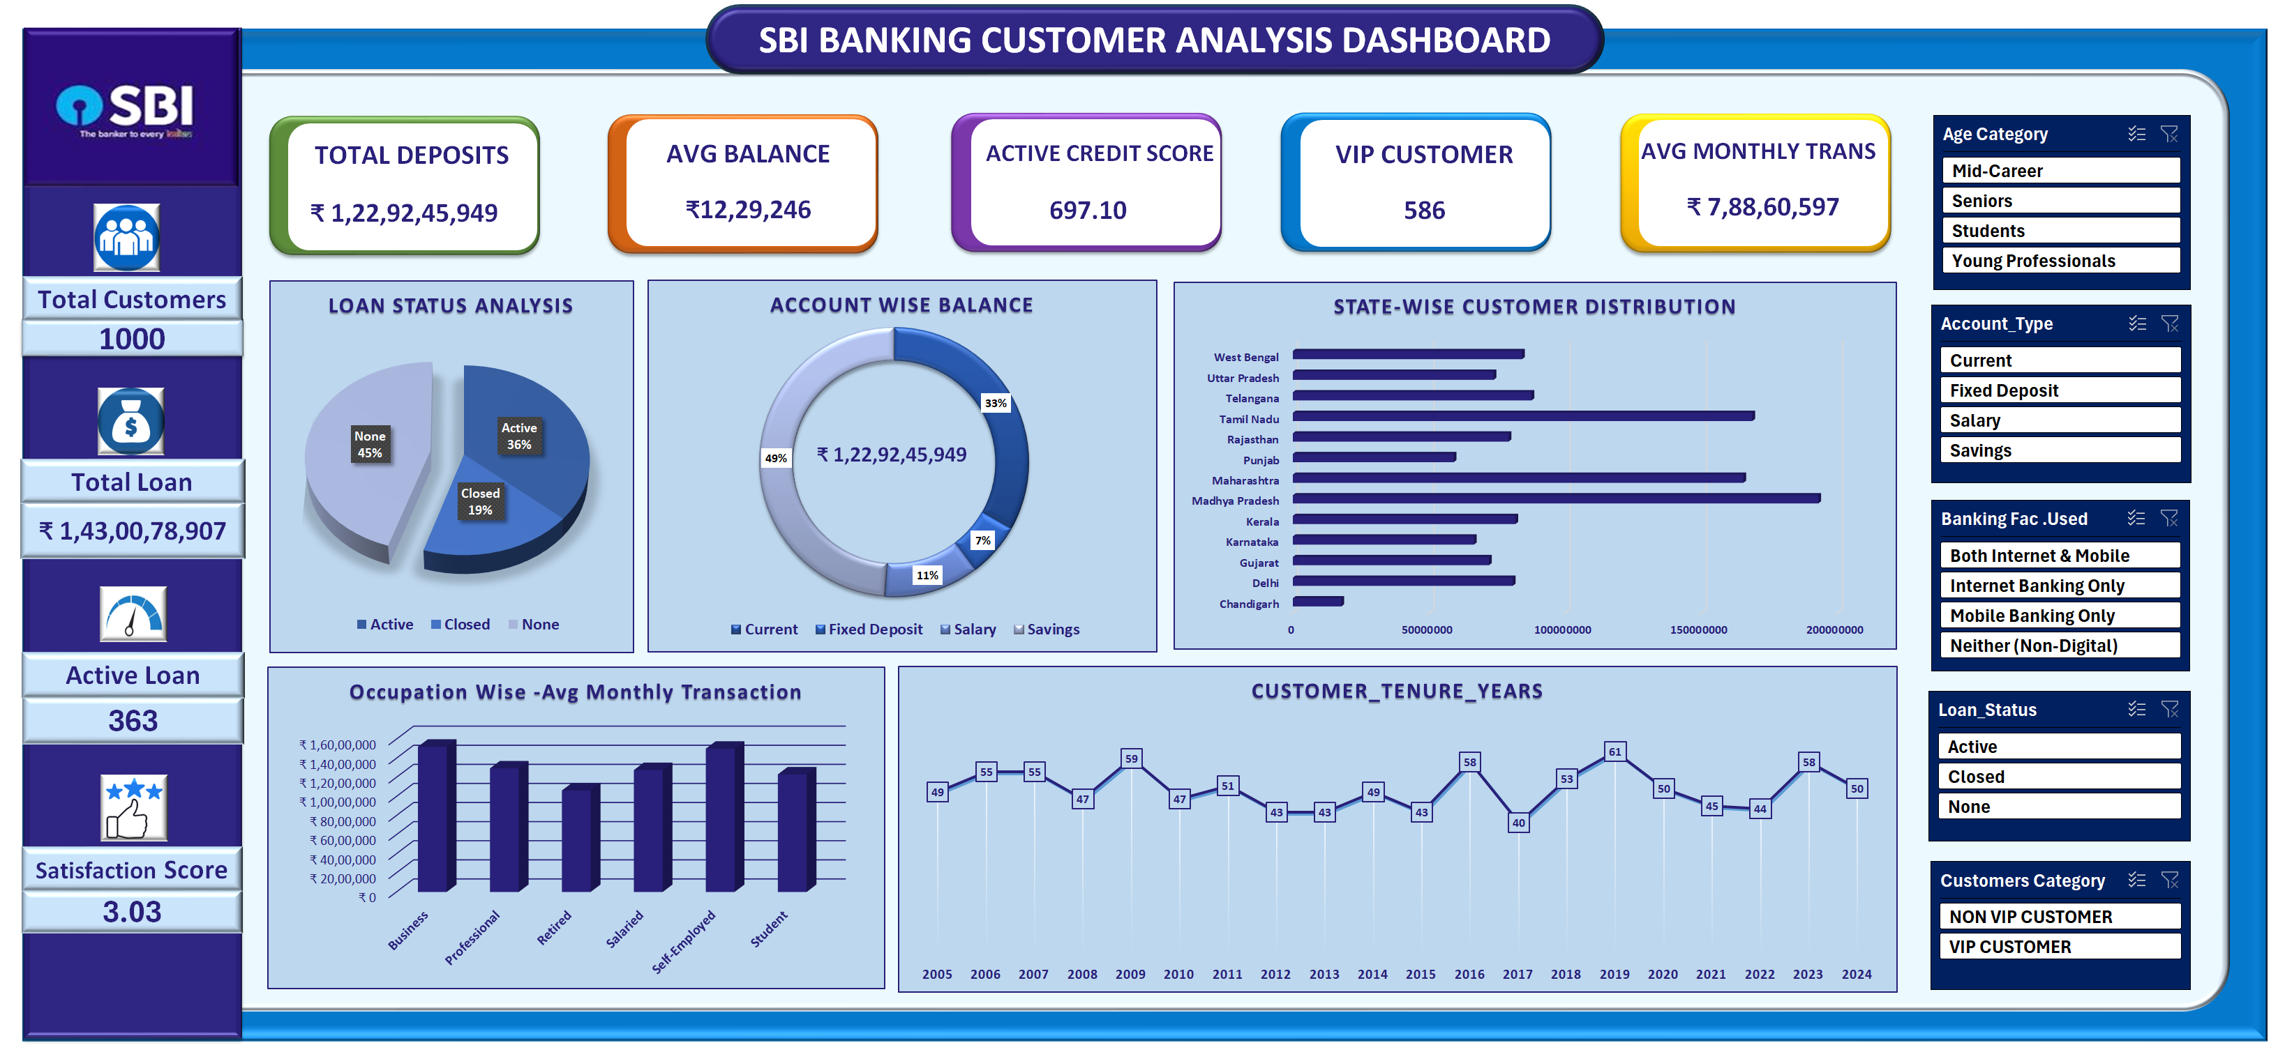
DASHBOARD

Slide 22
Conclusion & Business Insights
Power Query improved data quality and consistency
Excel formulas automated KPI calculations
Pivot tables simplified customer and financial analysis
Dashboard enabled quick decision-making using visuals
Project demonstrates end-to-end Excel data analytics workflow

Slide 23
THANK YOU

